Slide 1



Data Science Methods for Clean Energy Research (DSMCER) & Software Engineering for (SEMDS) Molecular Data Scientists
Knowledge and solutions for a changing world
Advancing data-intensive discovery in all fields
Be boundless
UW DIRECT
(Data Intensive Research Enabling Cutting-edge Tech)
https://uwdirect.github.io
Stéphanie Valleau
Chemical Engineering
Dave Beck (dacb)
eScience/Chemical Engineering
Notes:
In the SEDS portion of the class, we mostly focus on structure rather than content: knowing how to interact with the Shell, getting familiar with Github tools, etc. But in the DSMCER lectures, we’re going to focus more on content: on solving particular problems with the tools we learn about in SEDS. Know, the DSMCER material is also a set of tools that can be applied to a wide set of problems: and we aren’t going to get too mired down in any one domain science. But there is a difference.
Let me tell you about my experience with data science. I came to the University of Washington with absolutely no idea what “data science” meant. I had a little MatLab coding experience, but I found any type of computational work outright intimidating. So maybe a lot like you. And when I got started with programming, I was a little impatient with all this SEDS stuff. All this git add, git commit, git pull– it added nothing of value to my immediate problem! It didn’t help me analyze my data, etc. It only came over time working in the eScience Institute with data scientists that I began to see its value. So don’t give up yet.
Today, we’re going to focus on a subset of problems within data science, what we’re referring to as data visualization. So making pretty graphs. Kind of a fun one right?
By the end of today, I want you to feel comfortable using a few basic tools within three Python packages (Pandas, Matplotlib, and Seaborn) that can help you make some simple graphs.
I was you to feel comfortable accessing reference materials online to do more complex operations to make your graphs even prettier.
And I want to give you a few guiding principles when designing figures, plots, and graphs.
And ultimately, I want to convince you that you can and should try making your plots with Python instead of alternatives such as Excel or more sophisticated programs like GraphPad.

Slide 2
What is this class about?
Overview of Data Science methods
Basics of statistics
Tool selection
Best practices
Not about designing new algorithms
Group project using these methods
Provide you with computational tools and a computational mindset to tackle science problems

Slide 3
Course website & setup
Class website: https://uwdirect.github.io
Let’s go there now!
Equipment / work platforms
Laptops: use them ☺!
Slack: use it!
Software: install it!

Slide 4
Panopto recordings
We will record all lectures using Panopto – these will include the speaker’s screen and audio.
For virtual lectures (first week), your names / chats and videos are not recorded – even when your videos are turned on!

Slide 5
Code of Conduct
Please read and make sure to respect the code of conduct
https://uwdirect.github.io/code_of_conduct.html
If you find cases where the code of conduct is not being respected, let us know!
If you do not respect the code of conduct, we may refer to the university for action.

Slide 6
Two quarters of courses in one!
Two quarter courses make up training
CHEME 546: Software Engineering for Molecular Data Scientists (SEMDS)
One quarter (10 weeks)
CHEME 545: Data Science Methods for Chemical Engineering Research (DSMCER)
One quarter (10 weeks)
UW runs these concurrently
SEMDS
DSMCER
Week 1 |  | Week 2 |  | Week 3 |  | Week 4 |  | Week 5 |  | Week 6 |  | Week 7 |  | Week 8 |  | Week 9 |  | Week 10
AM
PM

Slide 7
Two quarters of courses in one!
Two quarter courses make up training
CHEME 546: Software Engineering for Molecular Data Scientists (SEMDS)
One quarter (10 weeks)
CHEME 545: Data Science Methods for Chemical Engineering Research (DSMCER)
One quarter (10 weeks)
We run these concurrently
SEMDS
DSMCER
Week 1 |  | Week 2 |  | Week 3 |  | Week 4 |  | Week 5 |  | Week 6 |  | Week 7 |  | Week 8 |  | Week 9 |  | Week 10
AM
PM

Slide 8
About Evan
Background – Chemistry (BS), Chemical Physics (MS, PhD), Physics (AM), Computer science (Secondary field)
Research – Solve chemical problems using computers (no gloves ;) ) – kinetics / exciton transport – from ab initio to ML predictions
Office: Zoom and Slack
Email: valleau+dsms@uw.edu
Group webpage: valleau-lab.com

Slide 9
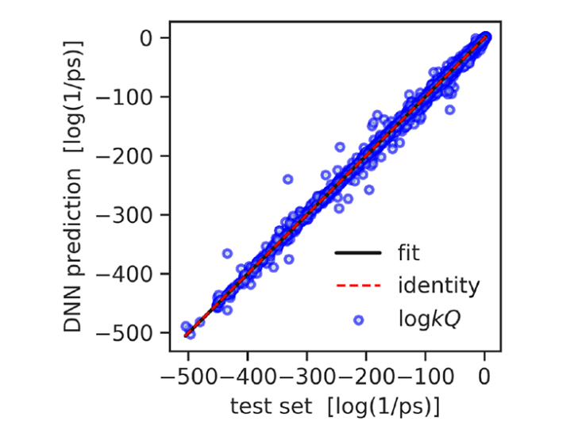
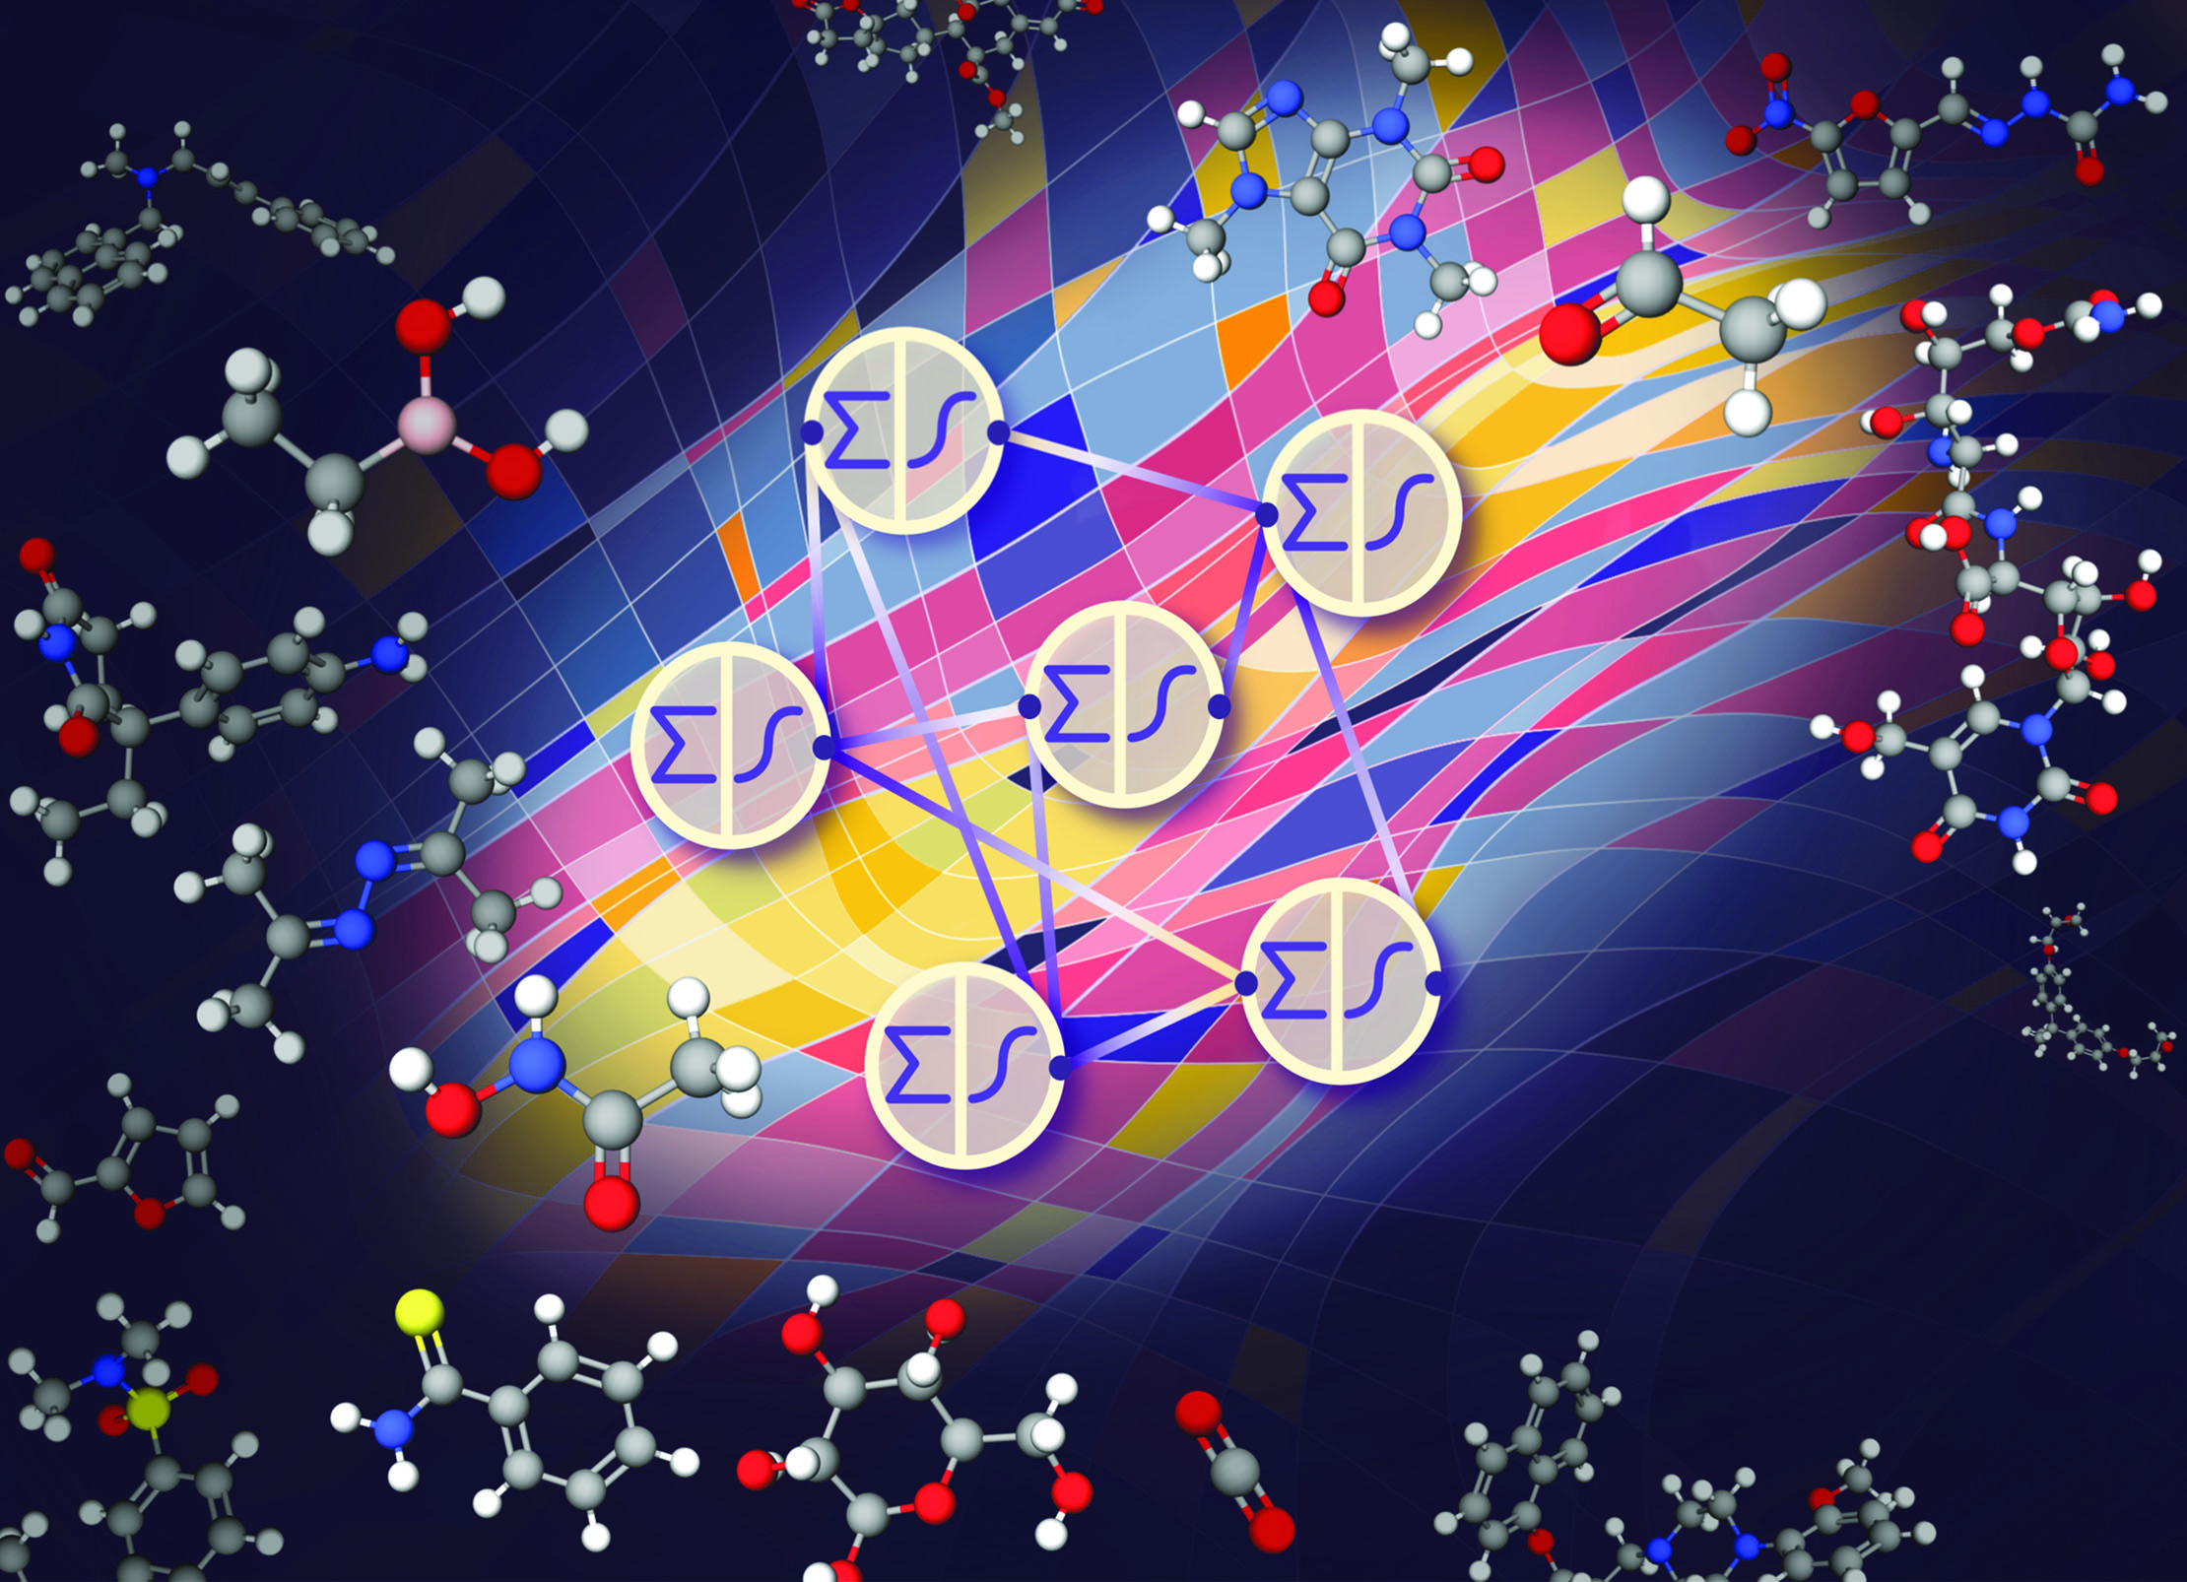
Data science + Kinetics
Predict reactivity using machine learning, ML, algorithms – e.g. neural networks (large speedup – months to minutes)
Quantum rate constants [1]
Kinetics [2]
[1] Komp, E.; Valleau, S. J. Phys. Chem. A., 124, 41, 8607–8613, 2020
[2] Komp. E; Janulaitis, N.; Valleau, S. PCCP, https://doi.org/10.1039/D1CP04422B, 2022

Slide 10
About Dave Beck
Background – Computer science, biology, chemistry (BS); Medicinal Chemistry (PhD); BioE (post-doc)
Research – Molecular data science with applications in energy, environment and health. Scientific software engineering for reproducibility.
Molecular mechanics
*omics
ML in molecular settings
Office: Zoom and Slack
Email: dacb@uw.edu

Slide 11
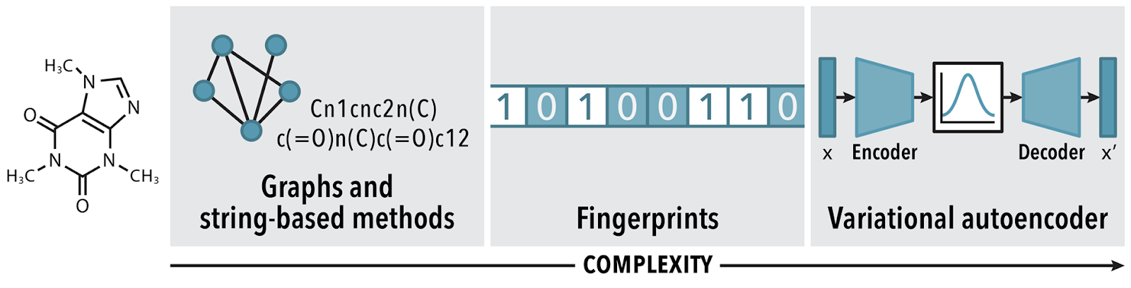
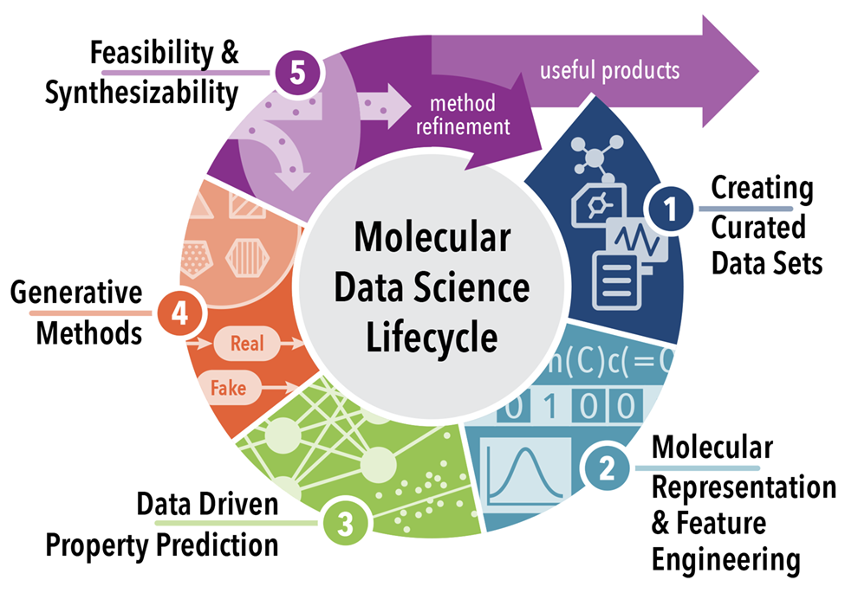
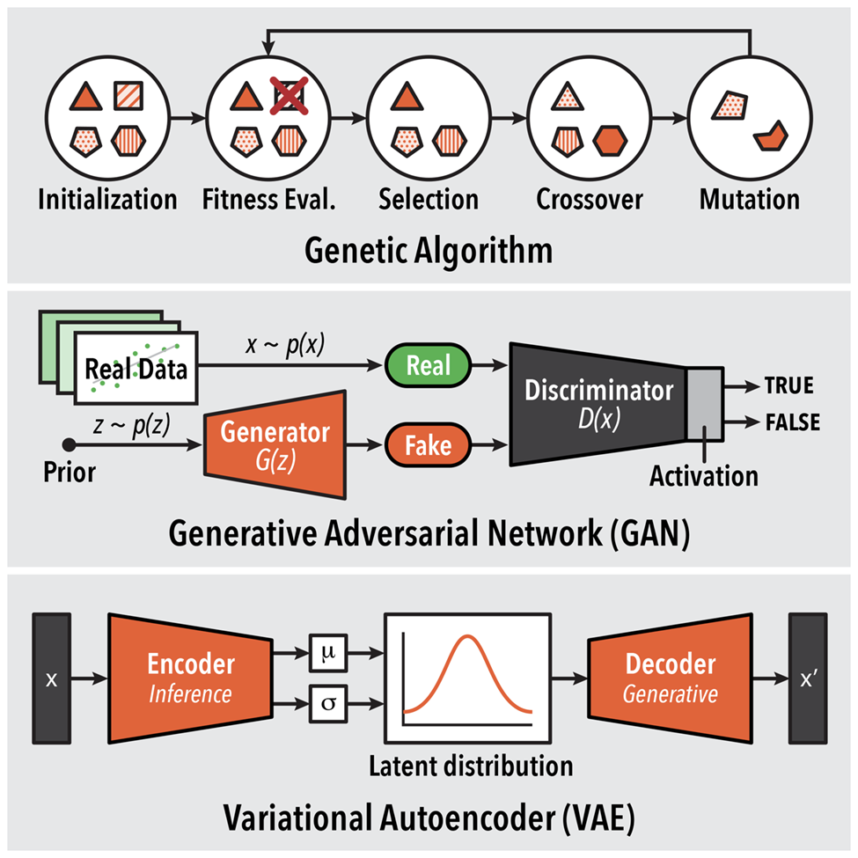
Molecular Data Science
Combining (a) diverse data sources and unique (b) molecular representations and (c) generative models to design new molecules.
(b)
(a)
(c)
[1] Ashraf, Joshi, Beck, Pfaendtner. Ann. Rev. Bio. Chem. Eng. https://doi.org/10.1146/annurev-chembioeng-101220-102232

Slide 12

About Evan Komp
I am concerned with leveraging machine learning to predict kinetic parameters allowing for speedy design of gas phase systems such as carbon capture in flue gas or precursor in chemical vapor manufacturing techniques. I am super excited to develop tools bringing the informatics of data science to kinetics design and to drive the community in terms of minimizing waste and energy use.
Office: Zoom and Slack
Email: evankomp@uw.edu

Slide 13
About Nisarg Joshi
I’m a third year PhD student in Pfaendtner Research Group. I use neural networks for my research to study simulations. Excited to be a part of DIRECT again! Data Science rocks!!
Office: Zoom and Slack
Email: nisargj@uw.edu

Slide 14
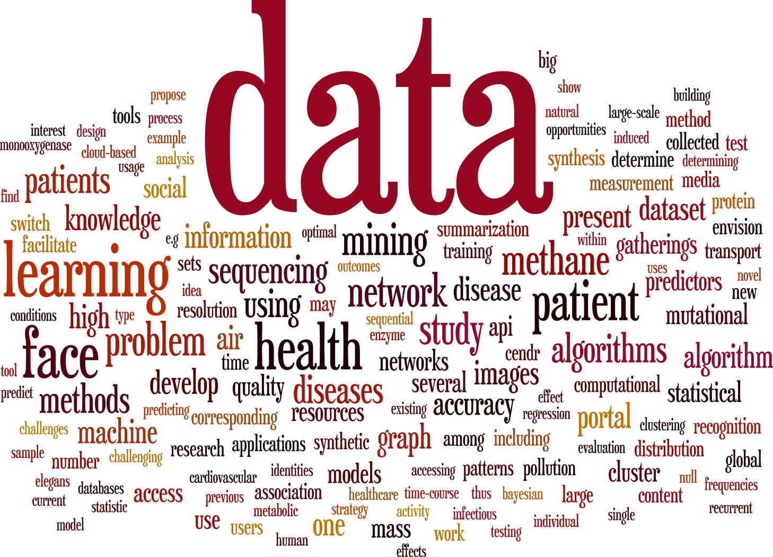
Data + science?
Science, Art & Engineering
Physical Sciences: Physics, Chemistry, Biology, Molecular science
Engineering: Environment, Materials, Civil, Electrical
Social Sciences: Psychology, Economics, Sociology, Public Policy

Slide 15
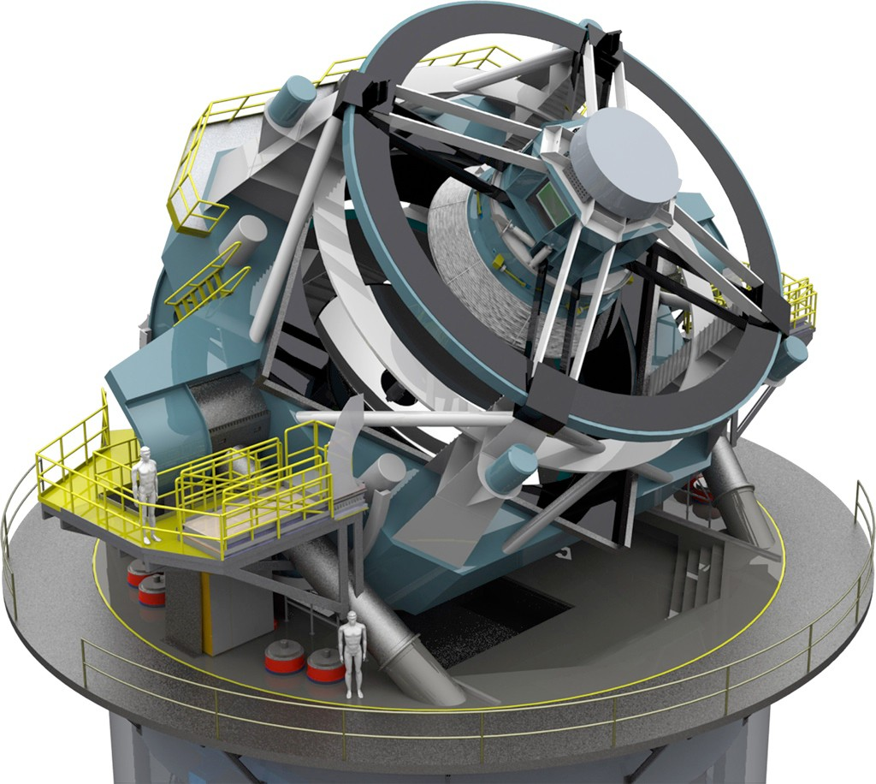

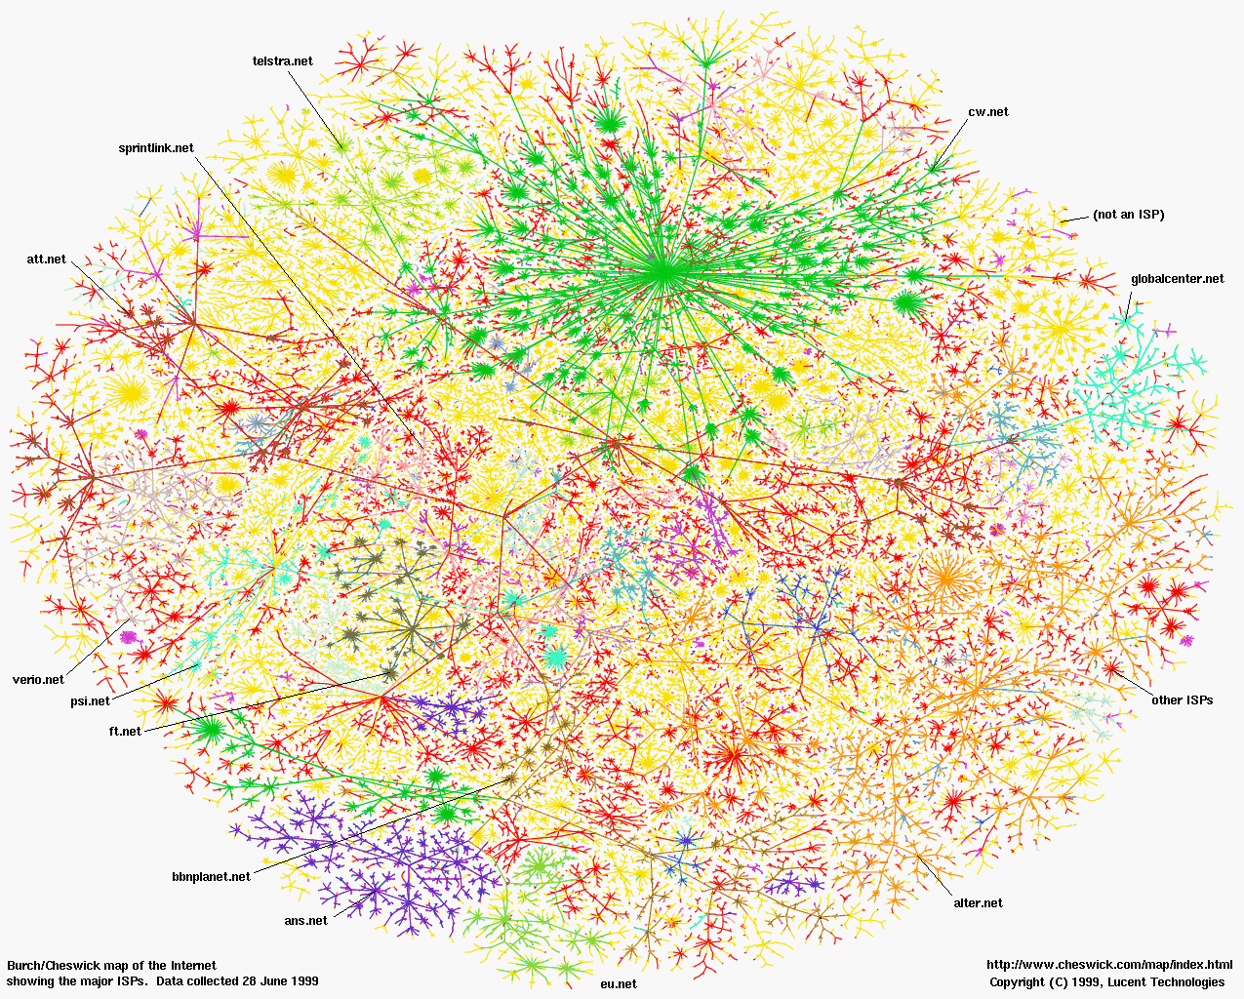
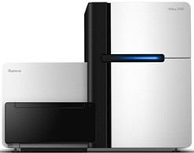
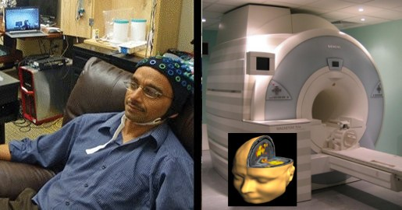
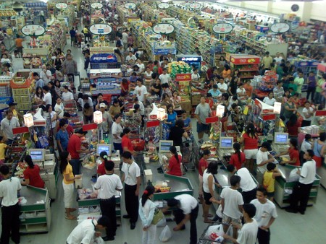
OMG, so much data!
All fields of science: “data poor” → “data rich”
Astronomy: LSST
Physics: LHC
Sociology: Social networks
Biology: Sequencing
Neuroscience: EEG, fMRI
Economics: POS terminals

Slide 16

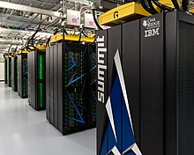
Computers then and now
1943
2018
ENIAC - Electronic Numerical Integrator and Computer
High-speed memory - 20 words (equivalent to about 80 bytes)
simple calculations involving 20 numbers of ten decimal digits
add and subtract 5000 times per second
SUMMIT - 2nd fastest in the world
Non-volatile memory per node 1600 gigabytes GB
mathematical calculations at the rate of 200 quadrillion per second, or 200 petaflops
https://en.wikipedia.org/wiki/Computer#First_computing_device
https://www.olcf.ornl.gov/summit/
Notes:
RAM 1963
The basic machine cycle was 200 microseconds (20 cycles of the 100 kHz clock in the cycling unit), or 5,000 cycles per second for operations on the 10-digit numbers. In one of these cycles, ENIAC could write a number to a register, read a number from a register, or add/subtract two numbers.
The ENIAC^{[37]} (Electronic Numerical Integrator and Computer) was the first electronic programmable computer built in the U.S. Although the ENIAC was similar to the Colossus, it was much faster, more flexible, and it was Turing-complete. Like the Colossus, a "program" on the ENIAC was defined by the states of its patch cables and switches, a far cry from the stored program electronic machines that came later. Once a program was written, it had to be mechanically set into the machine with manual resetting of plugs and switches. The programmers of the ENIAC were six women, often known collectively as the "ENIAC girls".^{[38][39]}
It combined the high speed of electronics with the ability to be programmed for many complex problems. It could add or subtract 5000 times a second, a thousand times faster than any other machine. It also had modules to multiply, divide, and square root. High speed memory was limited to 20 words (about 80 bytes). Built under the direction of John Mauchly and J. Presper Eckert at the University of Pennsylvania, ENIAC's development and construction lasted from 1943 to full operation at the end of 1945. The machine was huge, weighing 30 tons, using 200 kilowatts of electric power and contained over 18,000 vacuum tubes, 1,500 relays, and hundreds of thousands of resistors, capacitors, and inductors.^{[40]}

Slide 17
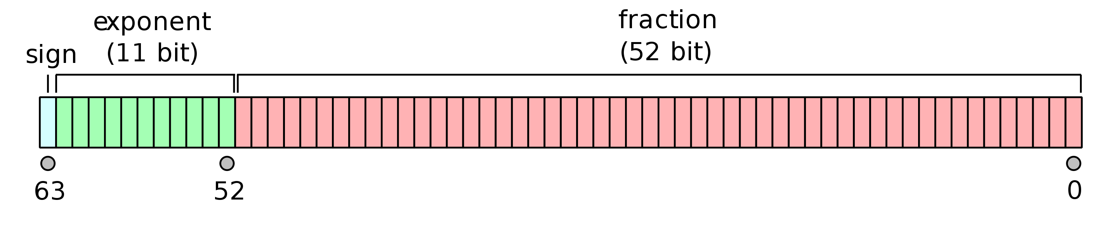
Need memory to store data
One double precision number (16 significant figures) needs 64 bits – 8 bytes
3.14159265358979311599796346844185161590576171875
One color image from your phone is ~24 million numbers
-> A dataset of images can be many terabytes in size, even modern computers cannot work on the whole dataset simultaneously

Slide 18
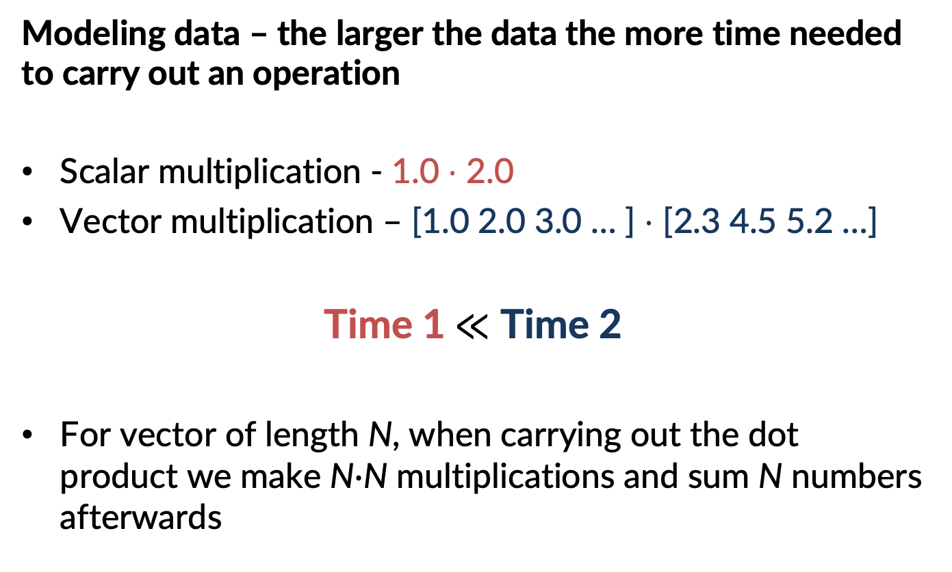
Need time & energy to compute
Modeling data – the larger the data the more time needed to carry out an operation
Scalar multiplication - 1.0 $⋅$ 2.0
Vector multiplication – [1.0 2.0 3.0 … ] $⋅$ [2.3 4.5 5.2 …]
Time 1$≪$ Time 2
For vector of length N, when carrying out the dot product we make N$∙$N multiplications and sum N numbers afterwards

Slide 19
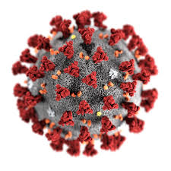

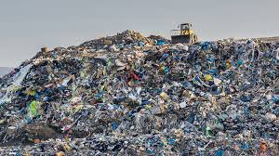
This cost can be prohibitive
Extracting properties from/using large dataset is computationally demanding: high memory cost & time demand
We need answers now for important problems
Drug/antiviral design
Global warming - ecological forecasting
Real-time sensing, learning, decision-making
Detecting hazardous weather
Ref: The National Science Foundation's (NSF) Harnessing the Data Revolution (HDR) Big Idea

Slide 20


Big Data + Big Compute =
Big Utility...
We will explore in this course:
what kind of data is out there, how can we operate on it, and what information we can extract
+ Big responsibility
And how to consider:
Code
Data
Useful information
Memory
Computational power
Energy and carbon

Slide 21
Your skillset is critical!
Code
Data
Useful information
Identify desired product
Process data
Design solution
Draw conclusions or utilize tool
Collect data and formulate assumptions
Incorporate domain knowledge
Interpret results
Physical scientists can do
Data scientists can do
You will be able to do!
Software engineers make sure all of this can be used by others!

Slide 22
New paradigm of data-intensive discovery and innovation
Deep domain knowledge
Data Science
Data management
Databases, scalable data handling, data curation
Statistics
Visualization
Machine learning
Supervised & unsupervised
Utility cost tradeoff
Software engineering

Slide 23


Data management
You’ve got lots of data, how do you manage it?
Not about lab notebooks anymore!
Databases
Structure and store large, heterogeneous data
Slice, subset, and retrieve it efficiently
Track provenance and metadata of your data
Relational databases
Structured Query Language (SQL)
Scalable data processing systems

Slide 24
New paradigm of data-intensive discovery and innovation
Deep domain knowledge
Data Science
Data management
Databases, scalable data handling, data curation
Statistics
Visualization
Machine learning
Supervised & unsupervised
Utility cost tradeoff
Software engineering

Slide 25
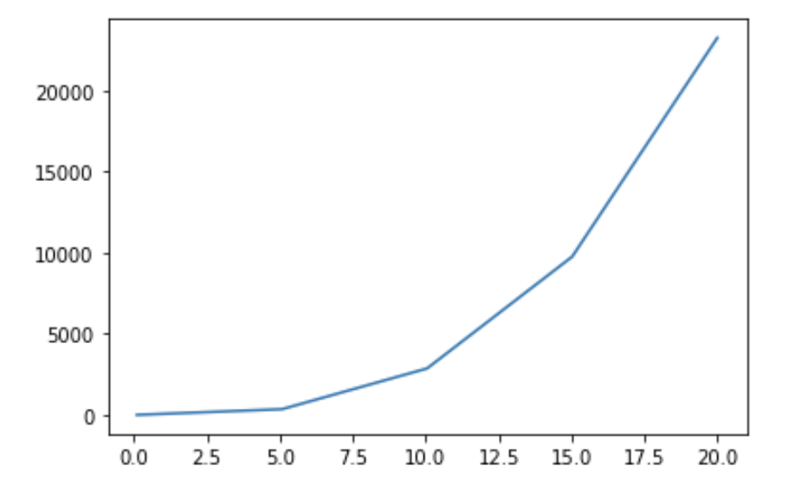
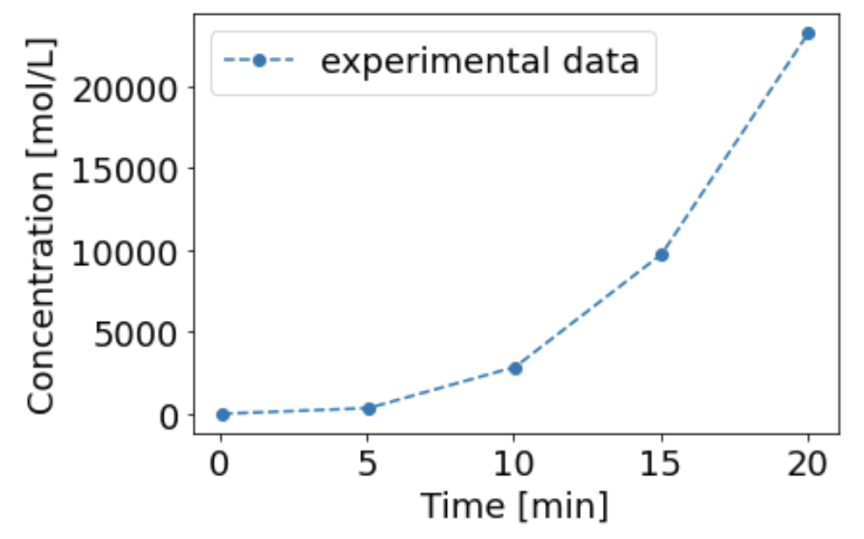
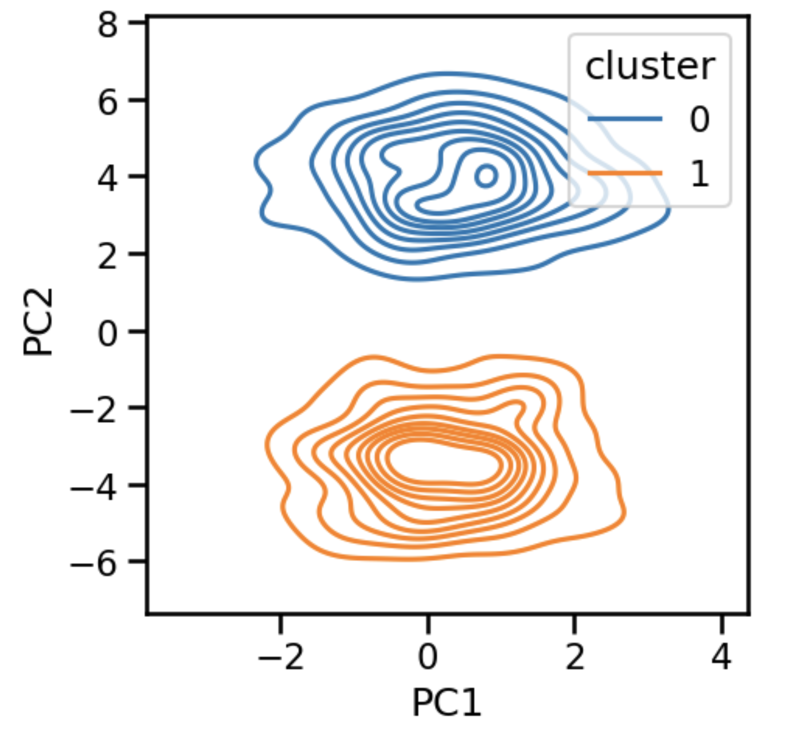
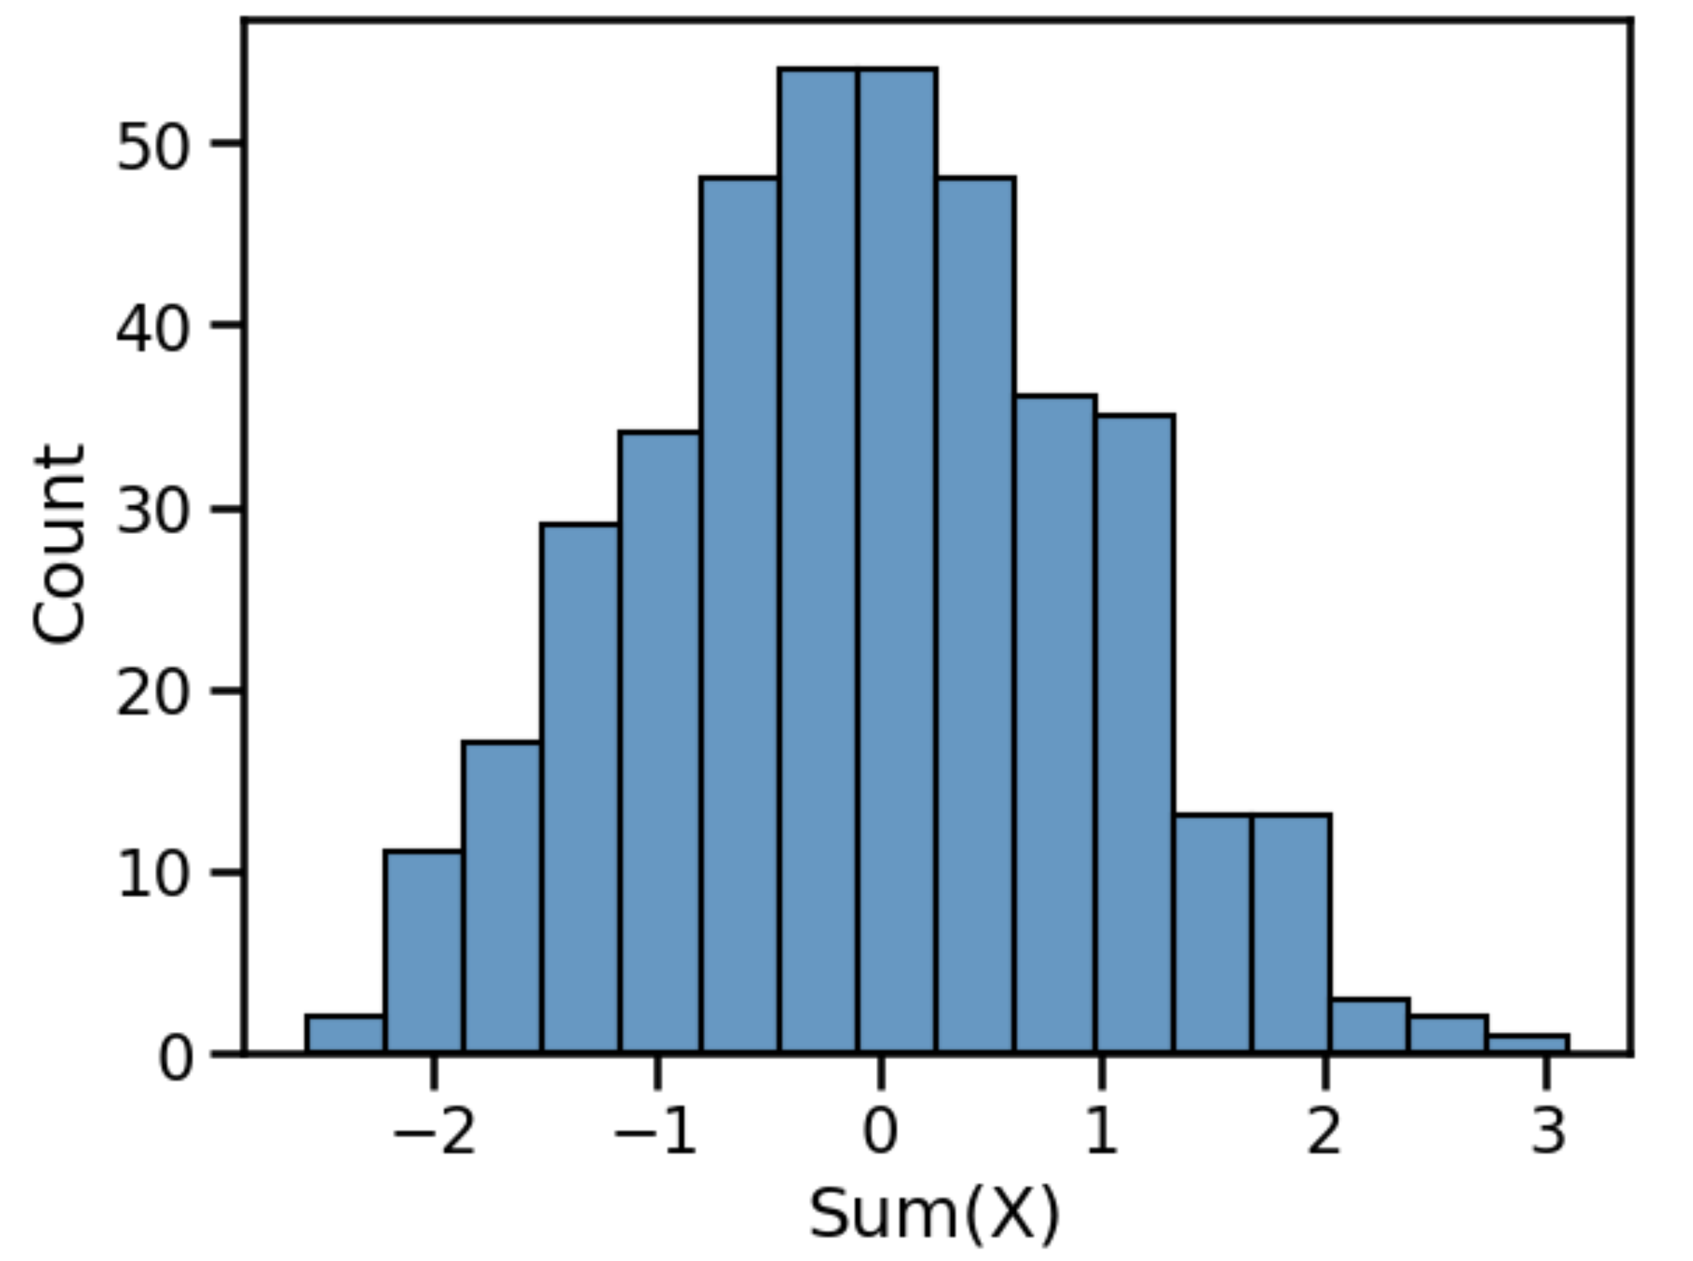
Visualization
How can visually display data in a useful way?
Clarity
Expressiveness

Slide 26
New paradigm of data-intensive discovery and innovation
Deep domain knowledge
Data Science
Data management
Databases, scalable data handling, data curation
Statistics
Visualization
Machine learning
Supervised & unsupervised
Utility cost tradeoff
Software engineering

Slide 27

Machine learning
Sign on Bonus!
www.slideshare.net/awahid

Slide 28
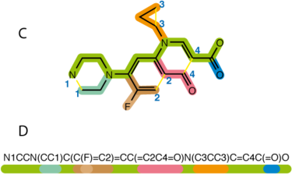
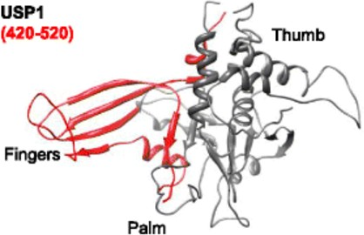


Supervised ML helps us accelerate
Supervised: Predict a measured, expensive label using low cost features
Example: develop structure-activity-relationship eg. binding affinity to cancer target
Database of 400,000 drug like molecules
Experimental inhibition activities against cancer drug target
Build a model that relates molecular features to a numerical measure of inhibition, dissociation constant (Kd)
For a new small molecule, predict the Kd?^{1,2}
+
=?
https://github.com/BeckResearchLab/USP-inhibition
https://github.com/BeckResearchLab/small-molecule-design-toolkit
Pearl Philip & Rahul Avadhoot

Slide 29
SML requires labeled data
Supervised
Features or predictors
Outcome
Molecule | Diffusion (nm/s) | Molecular Weight | C=C bonds | H-bond donors | H-bond acceptors | Kd (fM)
1 | 8 | 66 | 1 | 0 | 0 | 1
2 | 5 | 44 | 2 | 1 | 0 | 12
3 | 6 | 95 | 0 | 2 | 0 | 14
4 | 7 | 63 | 4 | 0 | 0 | 1
5 | 8 | 65 | 1 | 0 | 1 | 4
6 | 3 | 91 | 1 | 1 | 1 | 3
7 | 6 | 94 | 2 | 0 | 1 | 2
8 | 3 | 96 | 1 | 2 | 1 | 2
9 | 7 | 57 | 3 | 1 | 1 | 6
10 | 6 | 121 | 1 | 0 | 0 | 8

Slide 30

SML requires labeled data
Supervised
Features or predictors
Outcome
Molecule | Diffusion (nm/s) | Molecular Weight | C=C bonds | H-bond donors | H-bond acceptors | Kd (fM)
1 | 8 | 66 | 1 | 0 | 0 | 1
2 | 5 | 44 | 2 | 1 | 0 | 12
3 | 6 | 95 | 0 | 2 | 0 | 14
4 | 7 | 63 | 4 | 0 | 0 | 1
5 | 8 | 65 | 1 | 0 | 1 | 4
6 | 3 | 91 | 1 | 1 | 1 | 3
7 | 6 | 94 | 2 | 0 | 1 | 2
8 | 3 | 96 | 1 | 2 | 1 | 2
9 | 7 | 57 | 3 | 1 | 1 | 6
10 | 6 | 121 | 1 | 0 | 0 | ???????

Slide 31
Unsupervised ML can help us interpret
Clustering
Quick example from UW?

Slide 32
USML does not need labels
Unsupervised
Features
Molecule | Diffusion (nm/s) | Molecular Weight | C=C bonds | H-bond donors | H-bond acceptors
1 | 8 | 66 | 1 | 0 | 0
2 | 5 | 44 | 2 | 1 | 0
3 | 6 | 95 | 0 | 2 | 0
4 | 7 | 63 | 4 | 0 | 0
5 | 8 | 65 | 1 | 0 | 1
6 | 3 | 91 | 1 | 1 | 1
7 | 6 | 94 | 2 | 0 | 1
8 | 3 | 96 | 1 | 2 | 1
9 | 7 | 57 | 3 | 1 | 1
Mapping
?
?
?
?
?
?
?
?
?

Slide 33
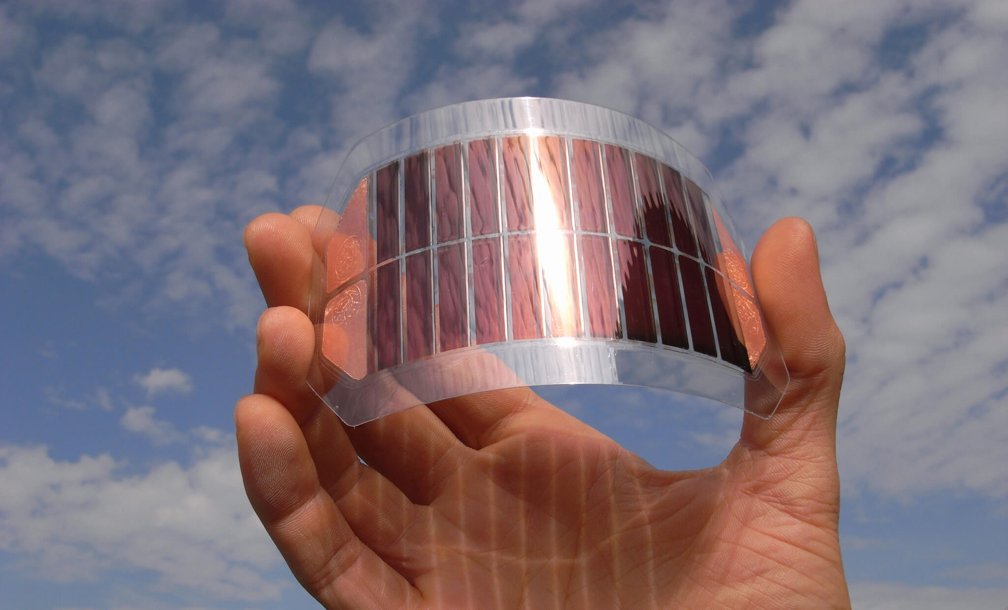
Dataset 1: HCEPDB
Source: Harvard Clean Energy Project – DOI 10.1021/jz200866s
Code
Data
Useful information
Data Description
2.3mil photovoltaic materials
Each has a chemical identity
Experimental measurements:
Open circuit voltage
Energy gap
Etc.
Synthesizing them is expensive
Interesting tasks
Can we predict solar cell capability without having to synthesize a new material?
How do the measurements taken correlate to each other
Are there types of materials we should explore?
https://www.ise.fraunhofer.de/en/business-areas/photovoltaics/perovskite-and-organic-photovoltaics/organic-solar-cells-and-modules.html

Slide 34
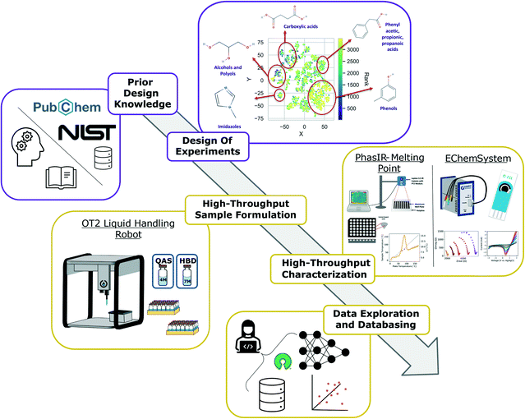
Dataset 2: High Throughput DES
Source: Pozzo Lab (Politi), UW ChemE - DOI 10.1039/D2ME00050D
Code
Data
Useful information
Data Description
Data for mixtures of 5 quaternary ammonium salts and 10 hydrogen bond donors
Experimental measurements for each:
Liquid at room temp
Electrolytes potentials
Interesting tasks
Can we interpolate the concentration a mixture will be solid?
Can we predict electrolyte potentials for new mixtures
Can we suggest new mixtures to try to learn more?

Slide 35
Dataset 3: Drug Traj. In Brains
Source:
Code
Data
Useful information

Slide 36
New paradigm of data-intensive discovery and innovation
Deep domain knowledge
Data Science
Data management
Databases, scalable data handling, data curation
Machine learning
Regression & classification
Supervised & unsupervised
Statistics
Visualization
Software engineering

Slide 37
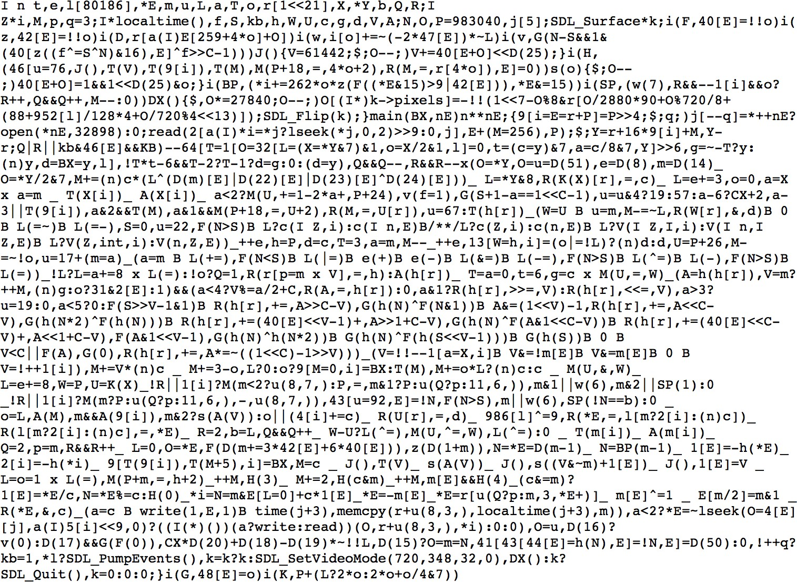
Software engineering
Your code should not look like this:

Slide 38
Software engineering
Scientific and engineering software tools are first class research products!
Programming is not software engineering
This is what CHEME/CHEM/MSE 546 is about!

Slide 39
Meet each other!
The best way to learn is from each other!
We will now move you to a breakout room ☺
Introduce yourselves (1st names and departments)
Appoint 1 facilitator (soonest birthday, e.g. today) and 1 scribe (farthest birthday, e.g., yesterday)
Go around the table, each person answers each of the following questions, then move onto next question.
What is Data Science?
What/who is a data scientist?
Why is Data Science a thing all of a sudden?
Why does Data Science matter, broadly, in my field of [insert]?
Why does Data Science matter, specifically, in my sub-discipline of [insert]?

Slide 40
What did you think?
Facilitator & scribe give us your update!

Slide 41

Data: Don’t be afraid of it!

Slide 42
DIRECT to the rescue!
Data Science Option
Data Intensive Research Enabling Clean Tech (DIRECT)
ChemE 545: Data Science Methods for Clean Energy Research
ChemE 546: Software Engineering for Molecular Data Scientists
ChemE 547: Capstone Project in Molecular Data Science

Slide 43
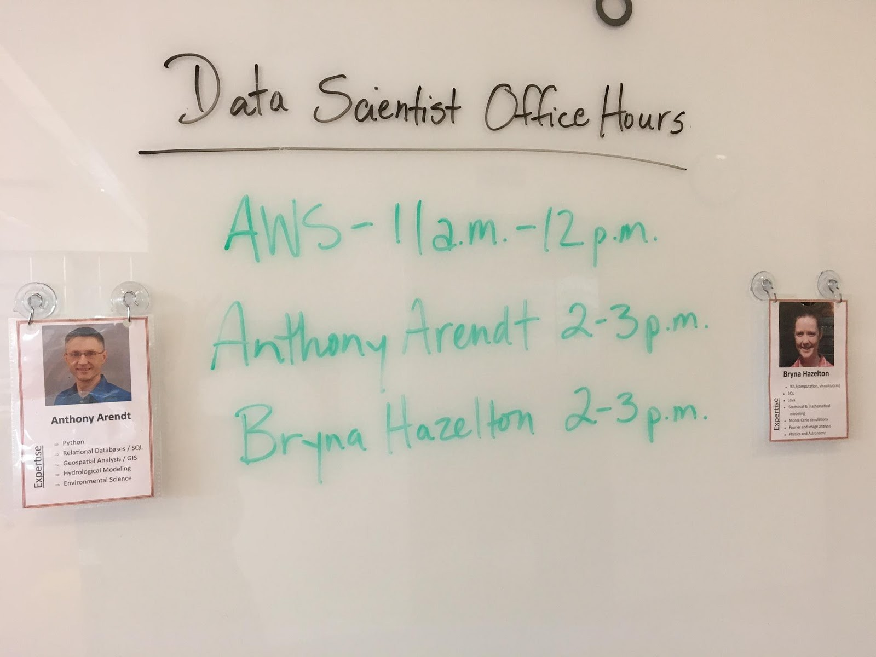

eScience to the rescue!
Data Scientist Office Hours
Get help with your data science questions
Data management
Machine learning
Statistics
Visualization
Software engineering

Slide 44

We must validate that the model does its job
Train / test split
How can you identify overfitting?
Partition your input data into
Training set (e.g. 80%) used to build the ML model
Test set (e.g. 20%) used to validate and characterize the error in the model
Data set
Training data
Testing data
Never ever ever ever ever contaminate your model training with data from the test set!!!

Slide 45
Questions?

